Slide 1


Slide 2
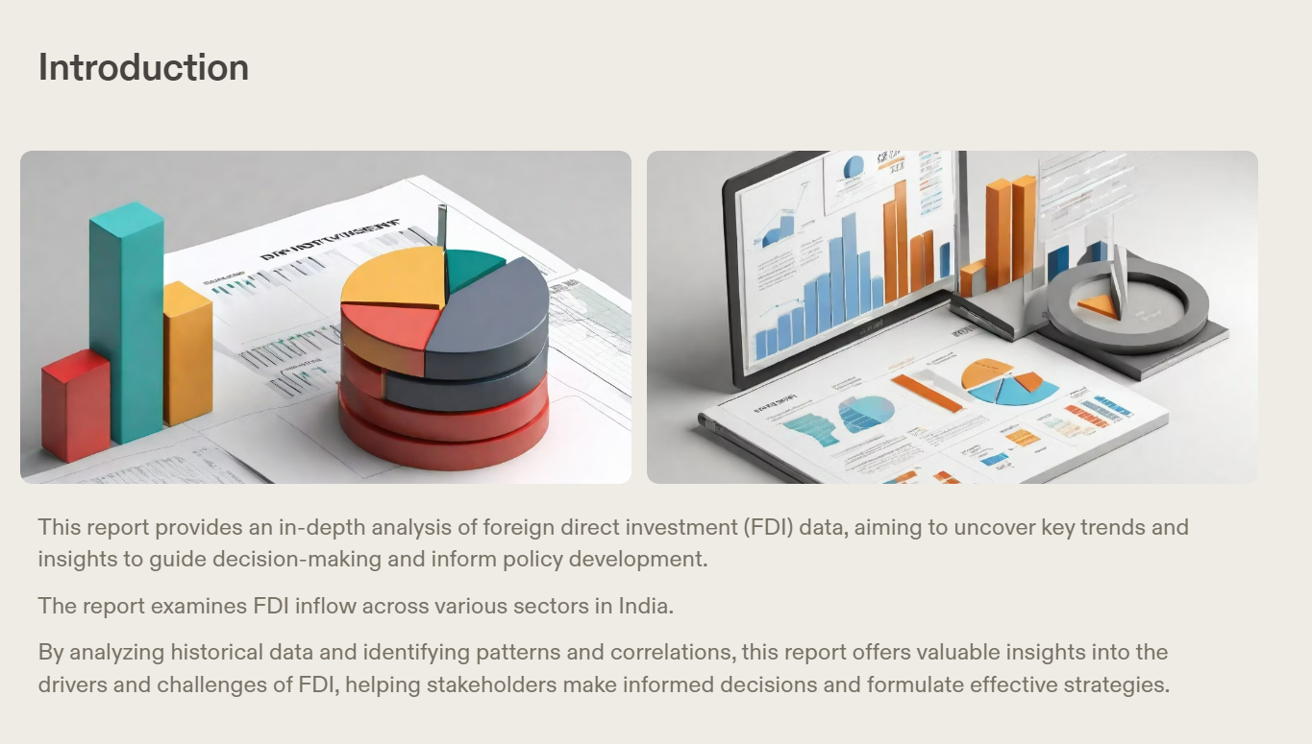

Slide 3
Investment is a game of understanding historic data of investment objects under different events but it is still a game of chances to minimize the risk we apply analytics to find the equilibrium investment.
To understand the Foreign direct investment in India for the last 17 years from 2000-01 to 2016-17. This dataset contains sector and financial year-wise data of FDI in India Sector-wise investment analysis Year-wise investment analysis.
Research
Question

Slide 4
Descriptive Analysis
2000-01 | 2001-02 | 2002-03 | 2003-04 | 2004-05 | 2005-06 | 2006-07 | 2007-08 | 2008-09 | 2009-10 | 2010-11 | 2011-12 | 2012-13 | 2013-14 | 2014-15 | 2015-16 | 2016-17
min | 0.000000 | 0.000000 | 0.000000 | 0.000000 | 0.000000 | 0.000000 | 0.000000 | 0.000000 | 0.000000 | 0.000000 | 0.000000 | 0.000000 | 0.000000 | 0.000000 | 0.000000 | 0.000000 | 0.000000
25% | 0.000000 | 0.000000 | 0.200000 | 0.215000 | 0.715000 | 1.230000 | 4.160000 | 9.950000 | 11.950000 | 7.880000 | 8.430000 | 22.720000 | 15.115000 | 16.610000 | 33.800000 | 30.000000 | 19.905000
50% | 4.030000 | 5.070000 | 11.010000 | 6.370000 | 9.090000 | 22.620000 | 25.820000 | 58.820000 | 84.880000 | 69.740000 | 58.070000 | 129.360000 | 95.410000 | 113.780000 | 177.220000 | 159.130000 | 110.860000
75% | 23.510000 | 44.830000 | 36.555000 | 38.660000 | 43.205000 | 63.855000 | 108.325000 | 279.270000 | 383.320000 | 341.595000 | 304.280000 | 593.525000 | 288.025000 | 473.060000 | 595.390000 | 519.070000 | 741.220000
max | 832.070000 | 873.230000 | 419.960000 | 368.320000 | 527.900000 | 1359.970000 | 4713.780000 | 6986.170000 | 6183.490000 | 5466.130000 | 3296.090000 | 5215.980000 | 4832.980000 | 3982.890000 | 4443.260000 | 6889.460000 | 8684.070000
The descriptive statistics of the dataset show :
There are some sectors with zero investment.
Year 2016-17 is the year with highest FDI while 2007-08 is the year with 2nd highest investment.
Year 2003-04 has lowest Foreign Direct Investment.

Slide 5
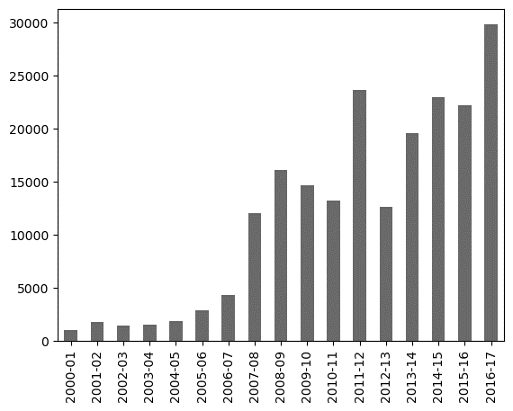
Key Findings
📈 Overall Increase in Foreign Direct Investment
The analysis of the foreign direct investment data reveals a significant increase in overall investment inflows. This indicates a positive trend and growing confidence in the market.
📈 Shift in Investment Focus
The analysis also highlights a shift in investment focus towards emerging markets. This indicates a growing interest in untapped opportunities and potential for higher returns.

Slide 6
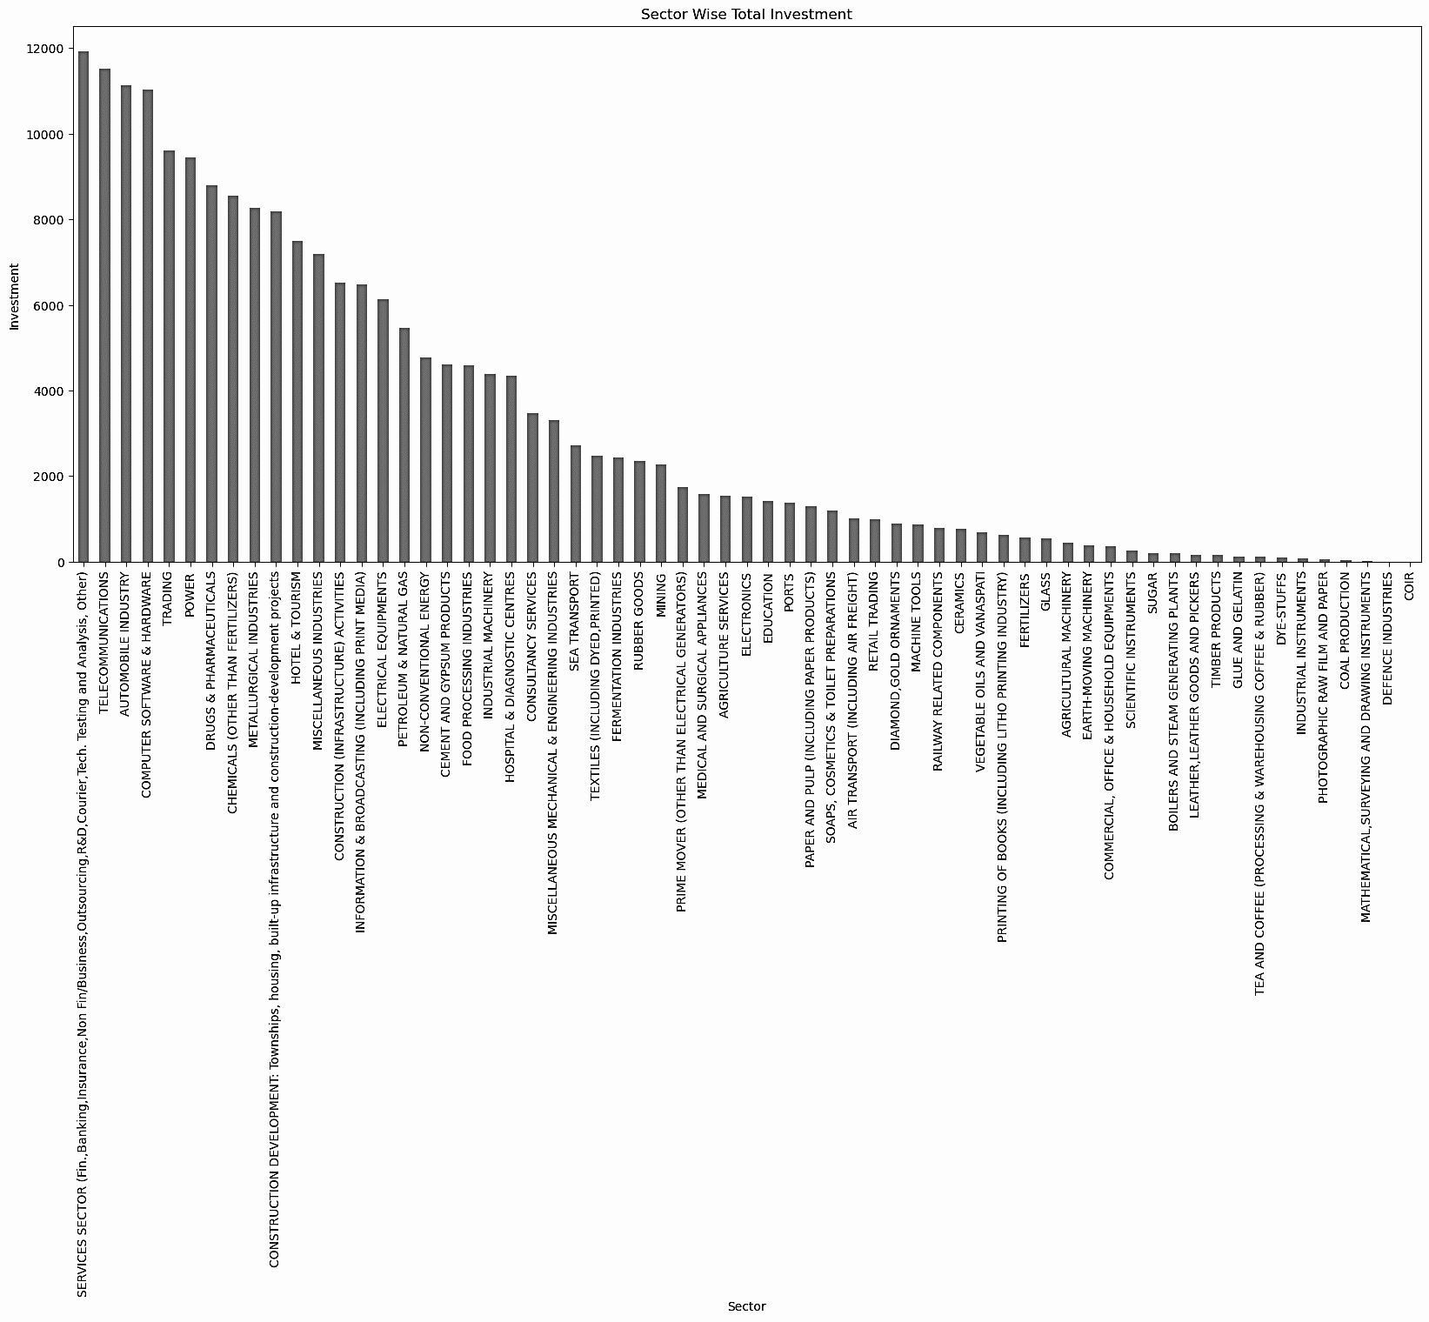
Service Sector is the sector with highest FDI while COIR ,defence and Mathematical Surveying and Drawing Instruments are the sector with zero Foreign Direct Investment while Coal Production also has negligible Investment as compared to Overall Foreign Direct Investment.

Slide 7
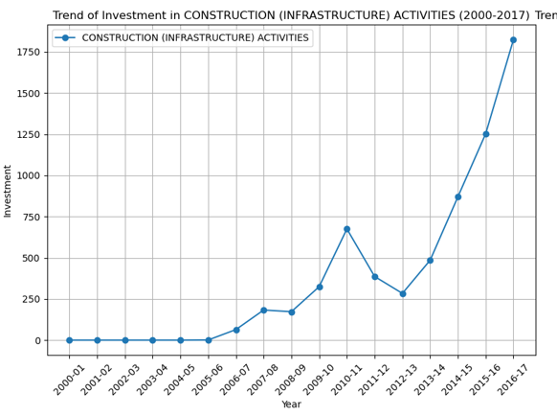
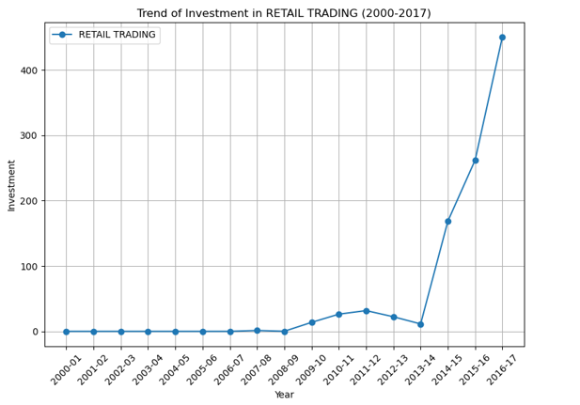
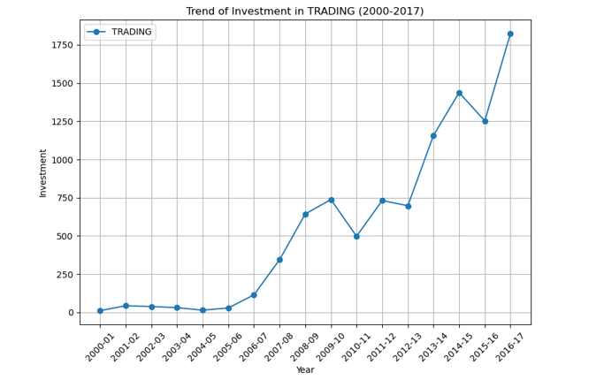
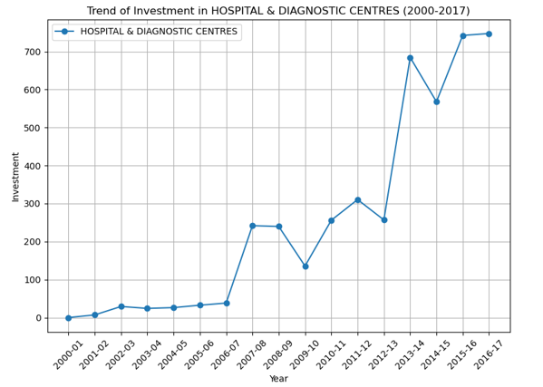
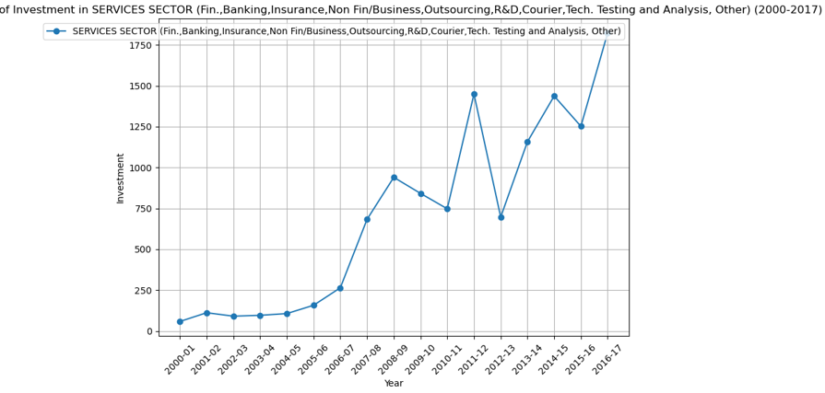

Slide 8
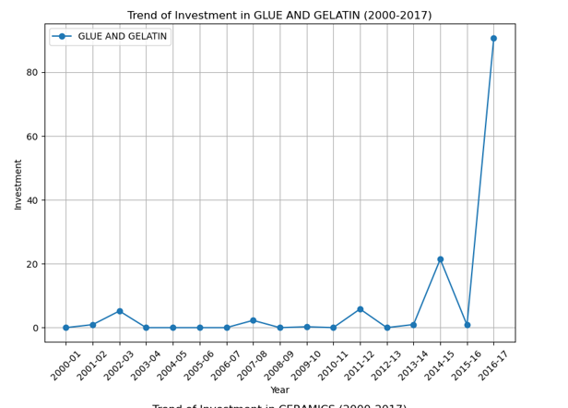
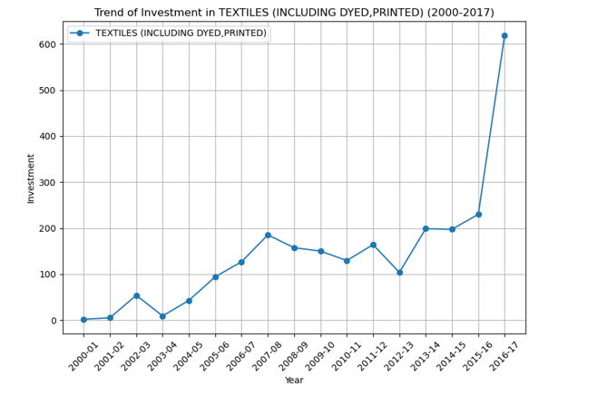
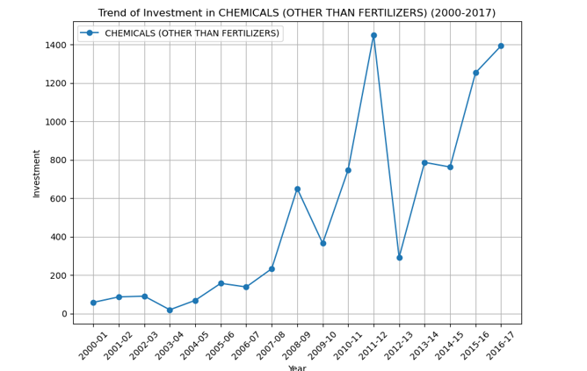
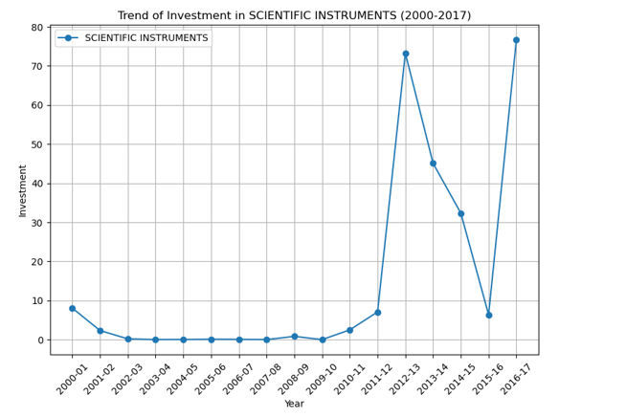
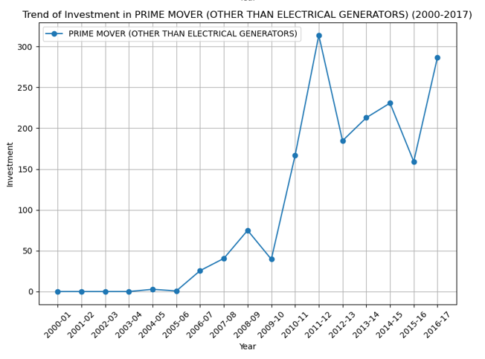
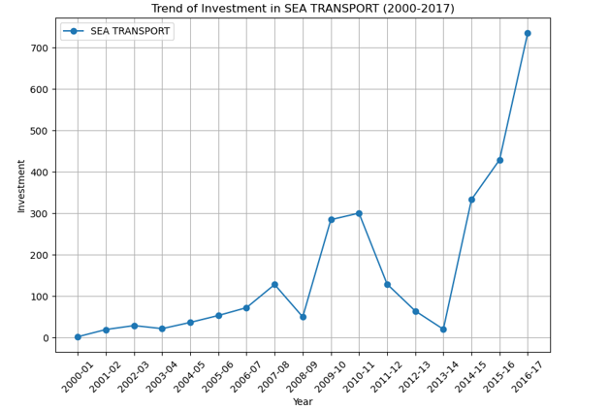
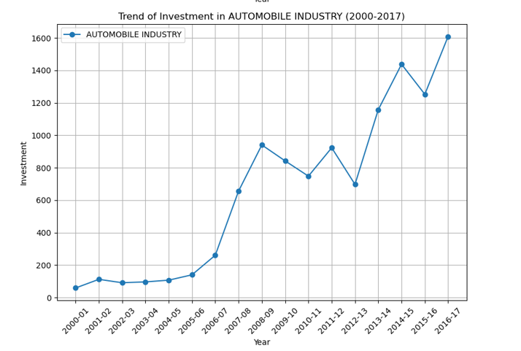
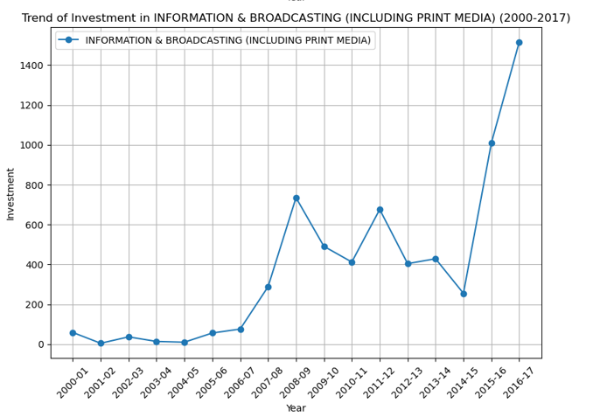
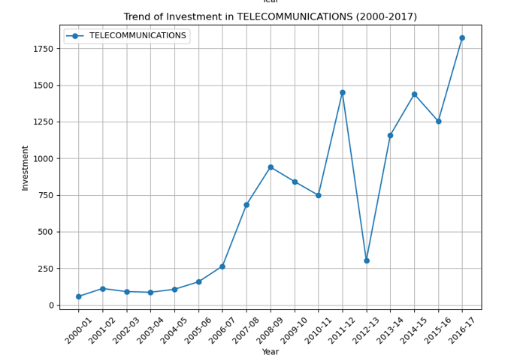
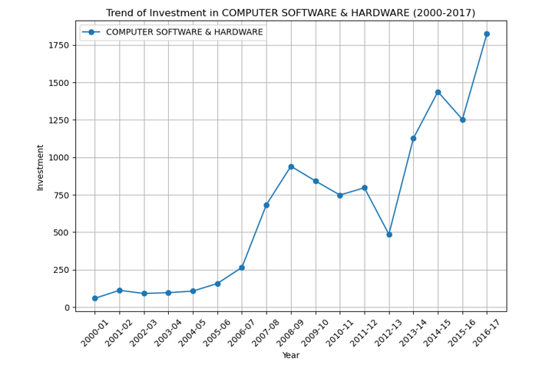
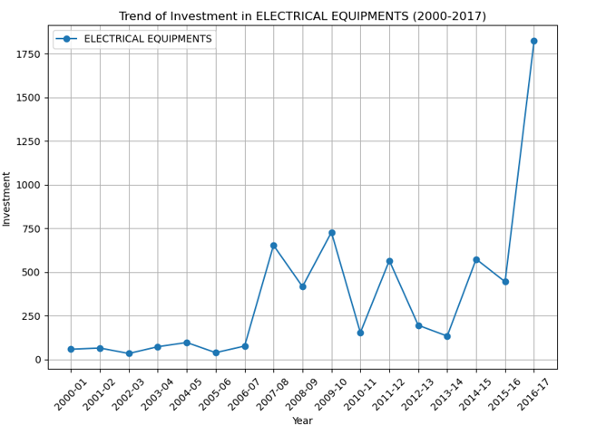

Slide 9
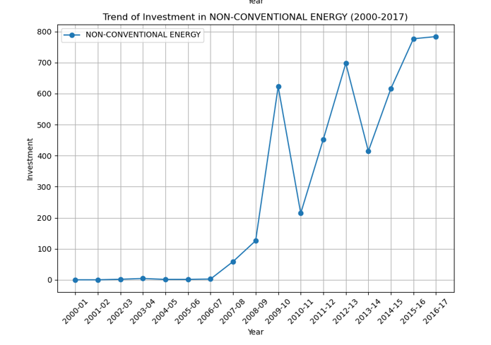
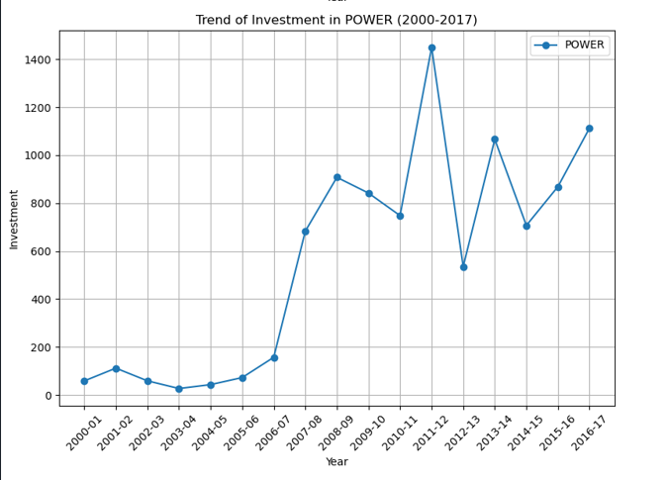
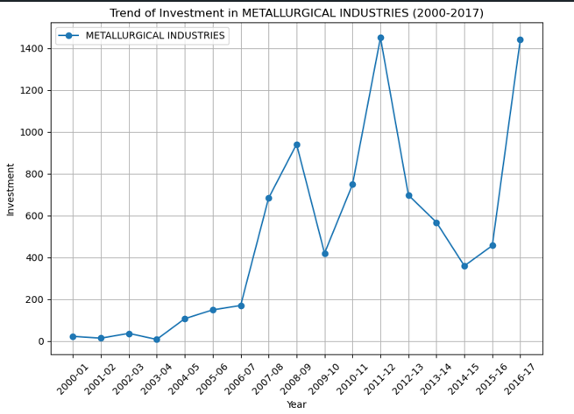
It shows Trend in Sector wise Foreign Direct Investment over the period of time for those sector where there is increase in FDI :
Construction (Infrastructure) Activity
Retail Trading
Trading
Hospital and Diagnostic Centre
Service Sector
Glue and Gelatin
Textile (including Dyed and Printed)
Scientific Instrument
Sea Transport
Auto mobile industry
Information and Broadcasting (including Print Media)
Telecommunications
Computer Software and Hardware
Electrical Equipment
Non Conventional Energies
Metallurgical Industries
Power
Prime Mover (Other than Generators)
Medical and surgical appliances
Chemicals (Other than fertilizers)

Slide 10
Over the period of time there is growth is Foreign Direct Investment from 2000 to 2017 and there is significant increase in the FDI of India. So it’s totally safe for investors to invest in India.
Service Sector is the sector with highest Investment till now as compared to others while COIR, Defense and Mathematical Surveying and Drawing Instruments are the sector with zero Foreign Direct Investment.
There are some sectors with increasing FDI and some sectors with decreasing FDI. List of increasing FDI sector are given below. Investor can invest in those sector.
Some sectors shows drastic rise in investment in recent years such as Glue and Gelatin, Information and Broadcasting (including Print Media), Electrical Equipment, Sea Transport. One must be careful while investing in these sector.
While there is growth in Sea Transport, Telecommunication, Scientific Instruments, Chemicals (Other than fertilizers) after a sharp decrease in investment.
Construction (Infrastructure) Activity, Retail Trading, Trading, Hospital and Diagnostic Centre, Service Sector, Textile (including Dyed and Printed), Auto mobile industry, Telecommunications, Computer Software and Hardware, Non Conventional Energies, Metallurgical Industries, Power, Prime Mover (Other than Generators), Medical and surgical appliances are those sector with shows continuous and slow growth so one can invest in this sectors without fear of loss.
Conclusion

Slide 11


Slide 12
Introduction
Welcome to the data analysis report on the Amazon sales data set. This report aims to provide valuable insights and trends based on the analysis of Amazon sales data. By analyzing this data, we can gain a deeper understanding of customer behavior, product performance, and market trends. This information can be used to make informed business decisions and optimize sales strategies.

Slide 13
Sales management has gained importance to meet increasing competition and the need for improved methods of distribution to reduce cost and to increase profits. Sales management today is the most important function in a commercial and business enterprise.
Do ETL: Extract-Transform-Load some Amazon dataset and find for me
Sales-trend -> month-wise, year-wise, yearly_month-wise
Find key metrics and factors and show the meaningful relationships between attributes.Do your own research and come up withyour findings.
Research
Question

Slide 14
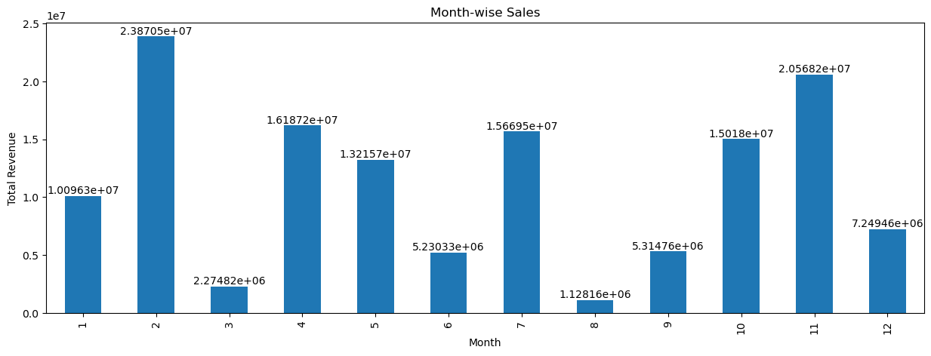
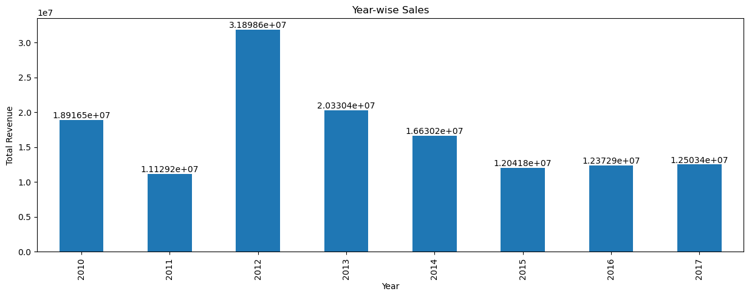
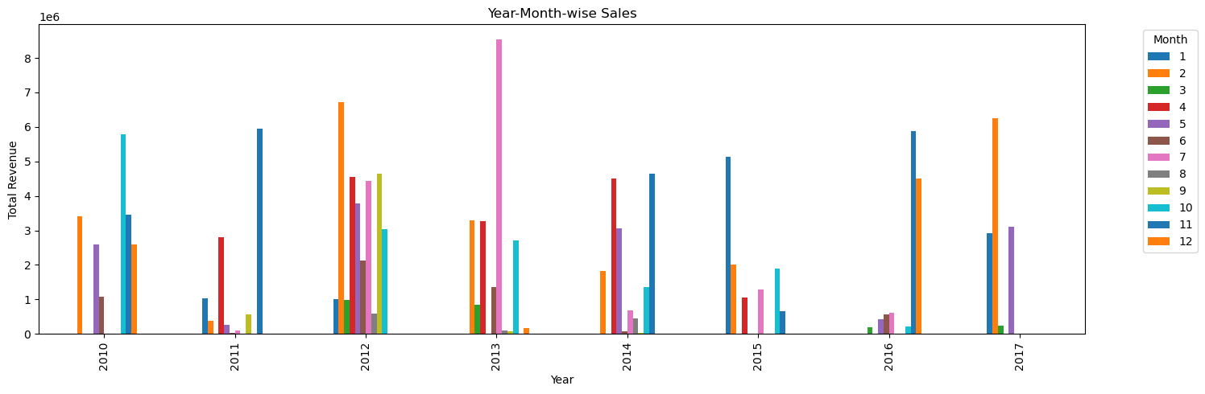

Slide 15
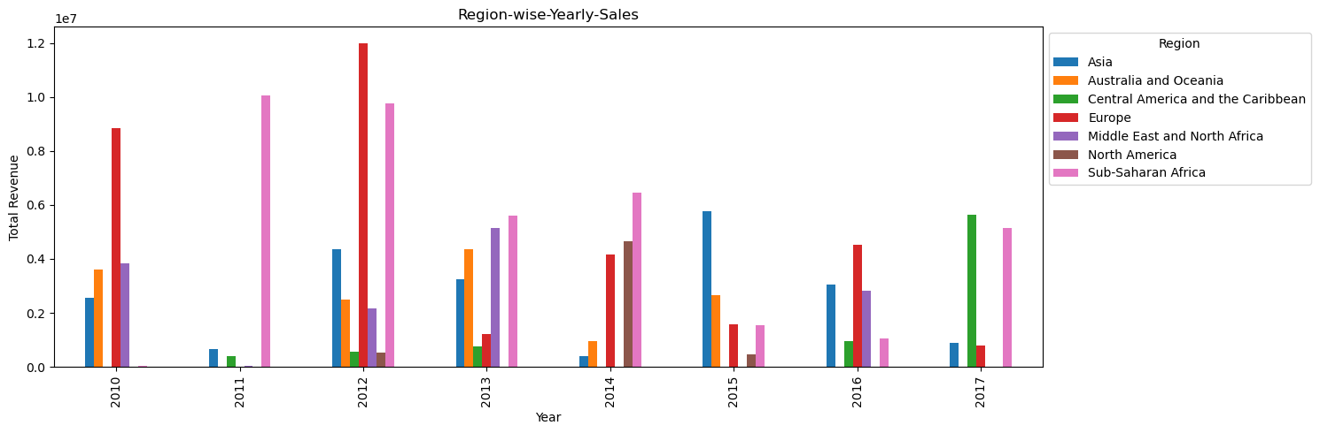
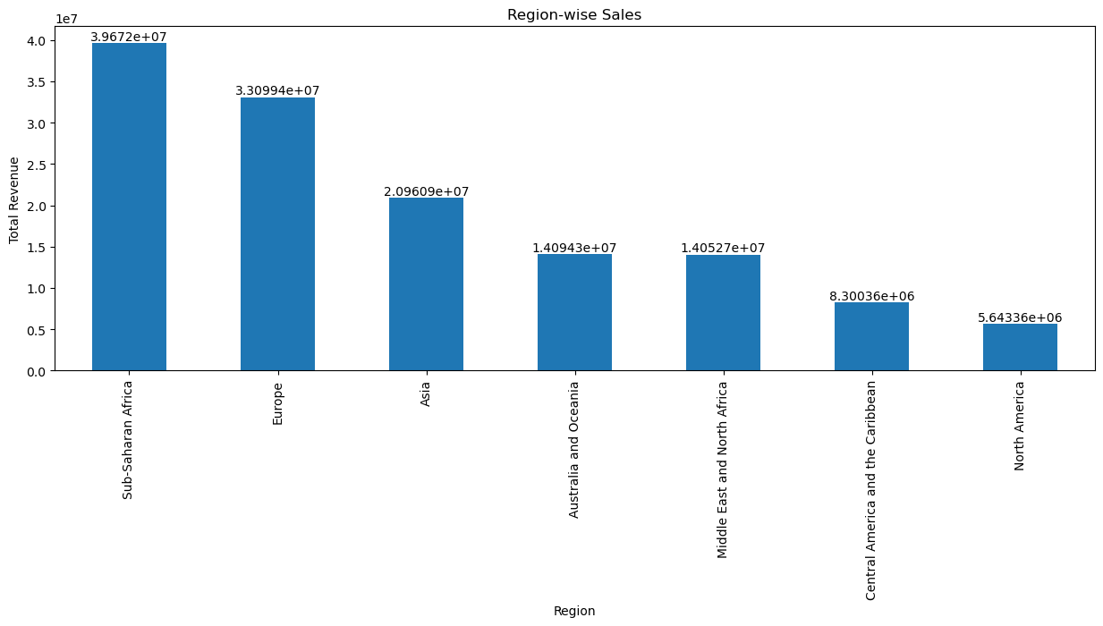
REGION WISE ANALYSIS
Insights
By looking at Region-wise Sales Bar graph we can say that Highest Sale or orders were recorded from Sub-Saharan Africa where as lowest was recorded from North American Continent, reason for this can be clearly seen from below plot.
From this we can conclude which region or sub-Continent has the Highest number of Orders in a given Year which has the lowest number of orders. eg : In 2012 Sales or Order placed were Highest in European Continent where as Lowest where for North American Continent or Region.

Slide 16
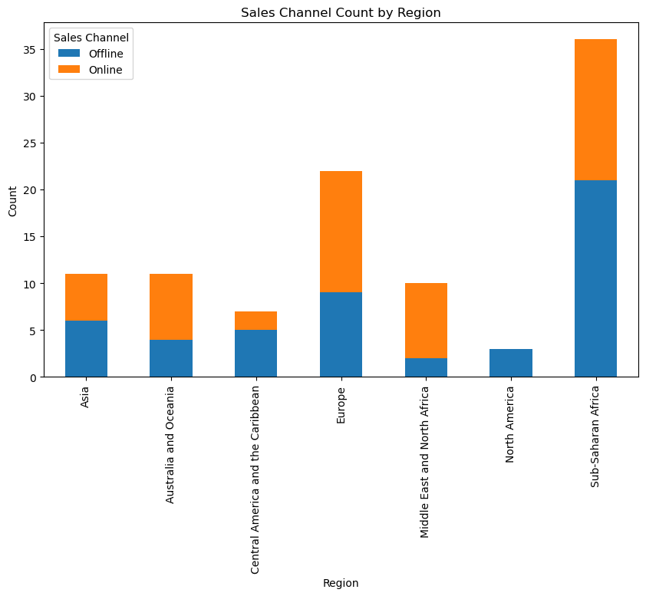
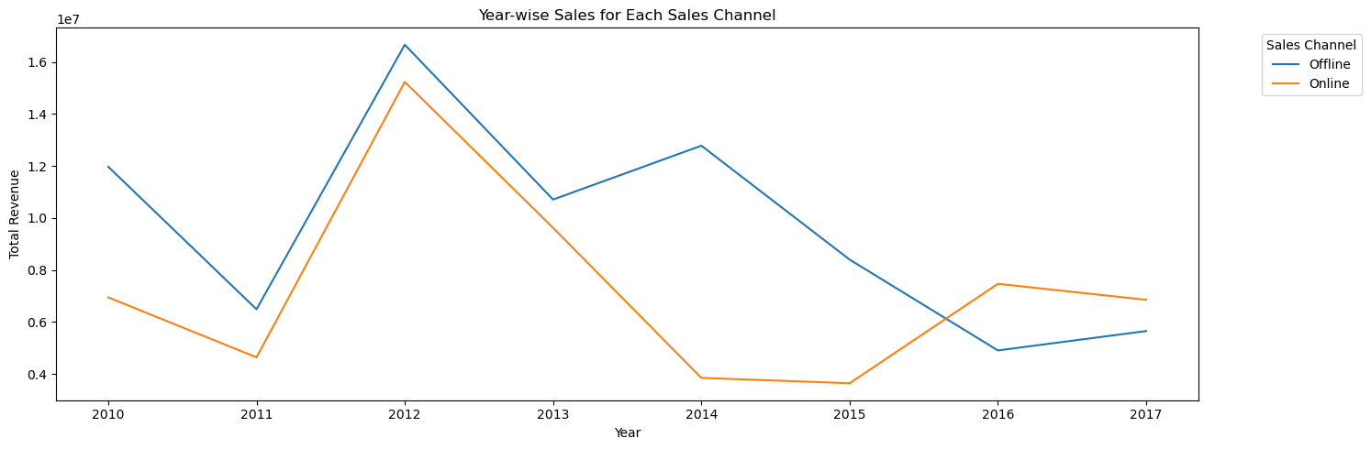
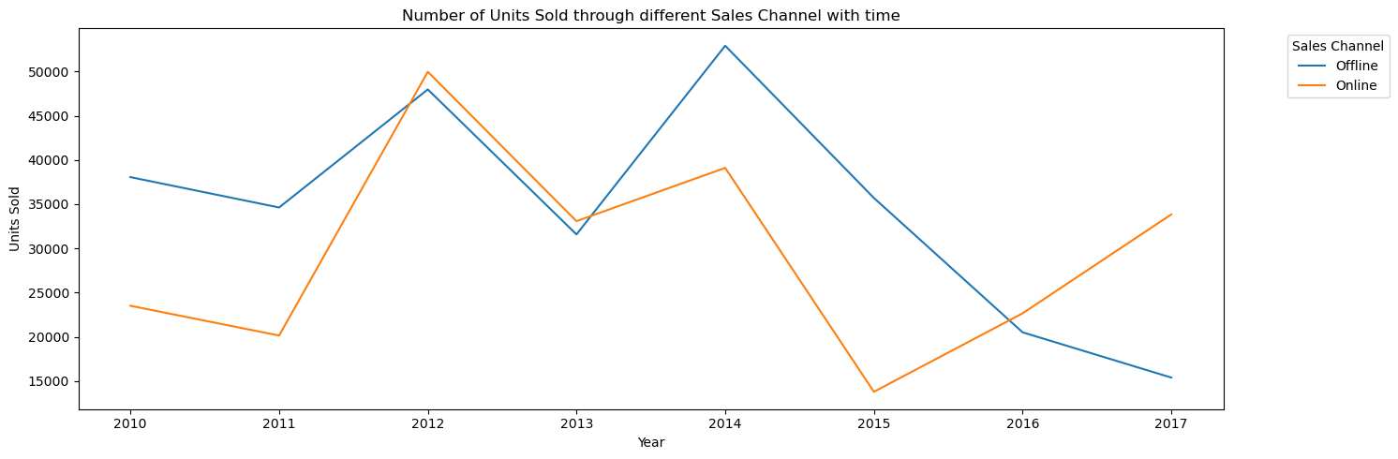
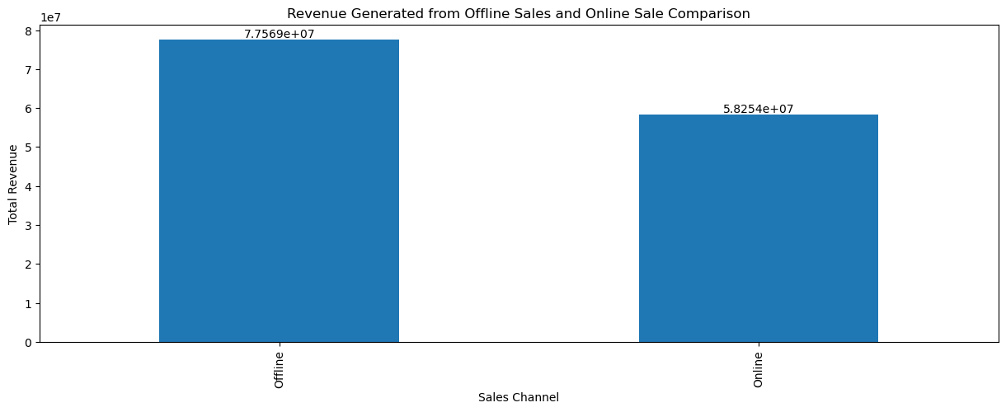
ANALYSIS OF SALES THROUGH SALES CHANNEL

Slide 17
Insights
Sales Channel Count by Region graph insight :
As you can see here there are no online order or online sales channel for North American Region and may be this be the reason for low orders in North American Continent where as European Continent has more number of online order as comapared to offline orders while Asian Continent shows almost equal number of order from both channels so may be in future online orders from Asian continent may Increase. South Saharan Africa has to work on online channel as their highest orders are from Offline channels.
Revenue Generated from Offline Sales and Online Sale Comparison graph insight :
More Revenue is generated from Offline orders still online orders have generated sufficient amount of Revenue and may be in future it will surpass the Business from Offline Orders.
Year-wise Sales for Each Sales Channel graph insight :
As concluded from before graph this graph clearly justify the above conclusion that is with time we can see Revenue Generated from offline order is Continuously falling where as Online orders are collecting More number of Revenue.
Number of Units Sold through different Sales Channel with time graph insight :
Reason Behind Falling Offline Revenue and Increasing Online Revenue is clearly seen fro here.

Slide 18
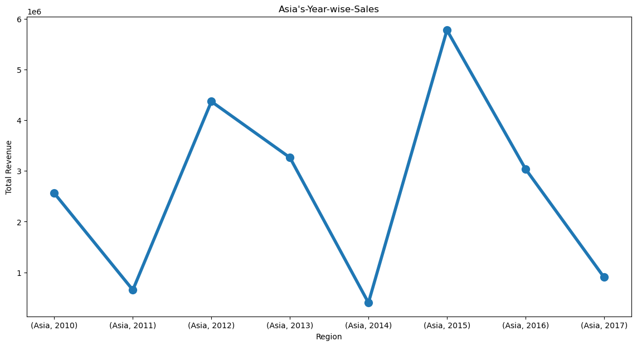
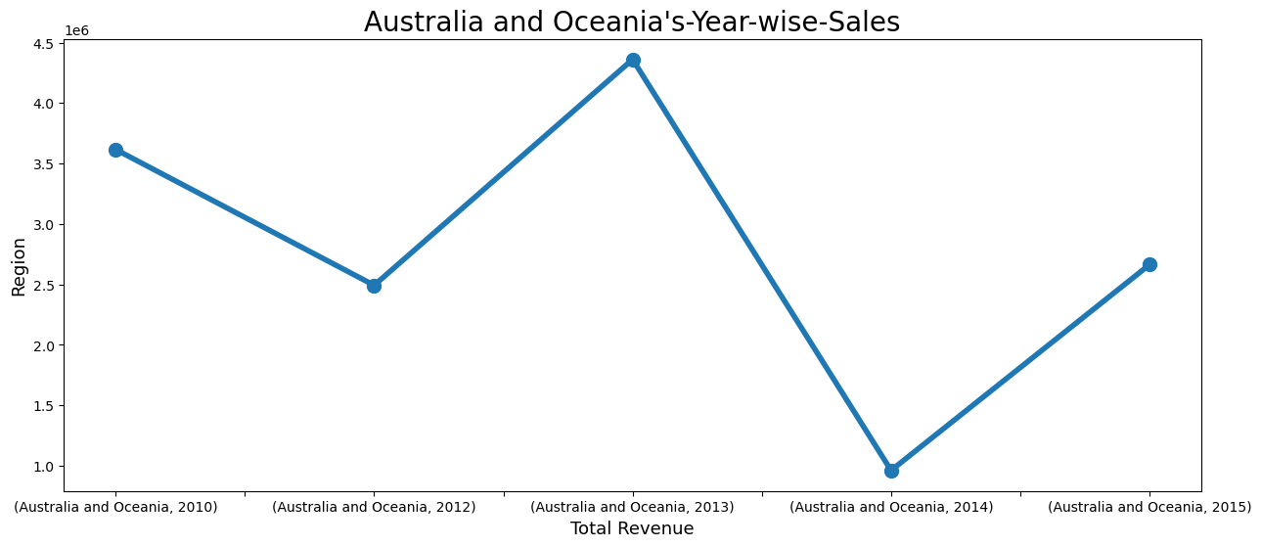
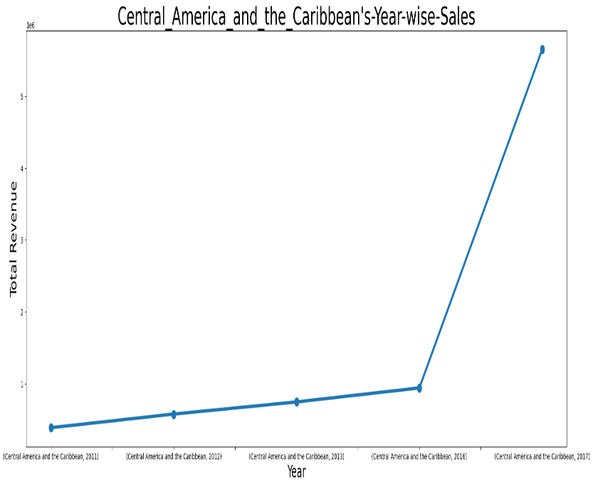
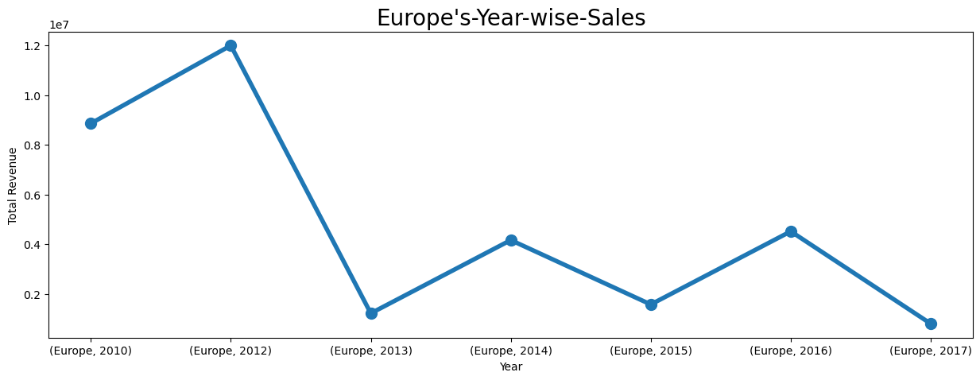
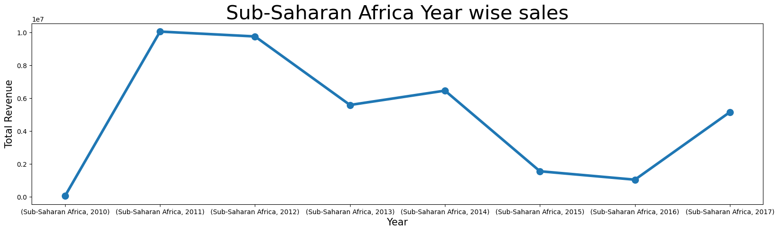
ANALYSIS OF SALES TREND IN DIFFERENT REGION OVER THE PERIOD OF TIME

Slide 19
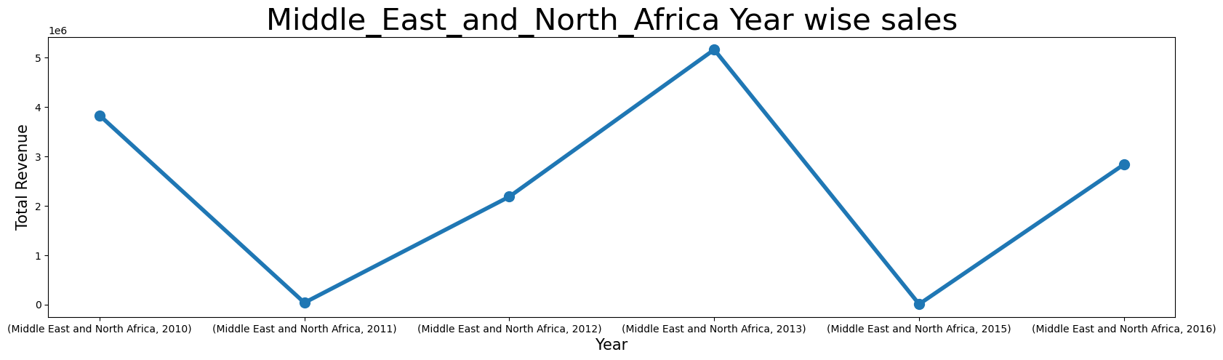
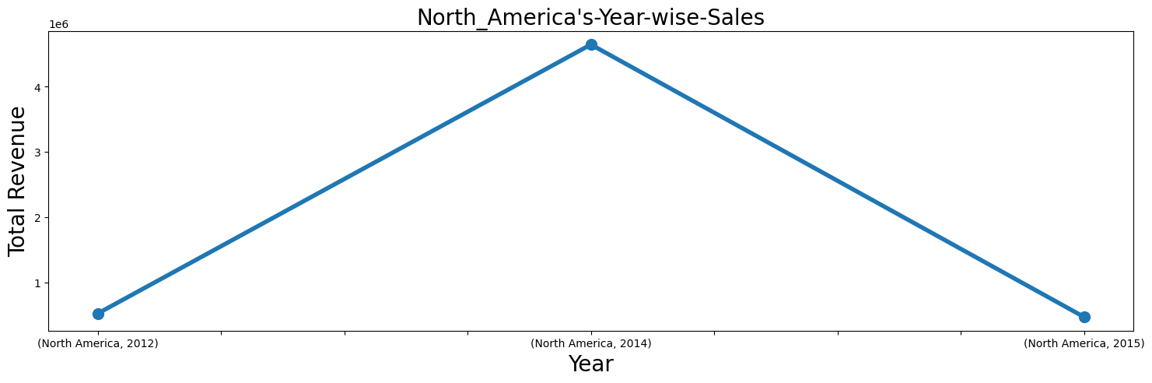
Insights
Asia, North America and European Region are those region where the sales of amazon is decreasing with time and therefore amazon needs to pay more attention in this regions.
While Australian and Middle East and North African region shows continuous increase and decrease in sales.
In Sub Saharan African Region the sales initially was very high but with time it's falling and also it's a region of highest Revenue for Amazon so they need to pay special attention in this region.

Slide 20
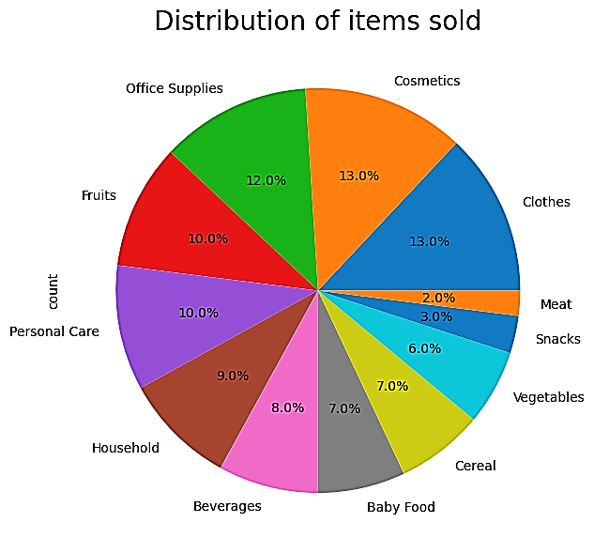
ANALYSIS OF ITEM SOLD
From here we can conclude that the sales of amazon is does not depend on one particular or two item this a good sign.
The distribution of sales over various item makes the amazon a strong company.
While Office supplies, Cosmetic, Fruits etc have a major contribution in sales meat and snacks have very weak sale. Attention should be paid for this items.

Slide 21
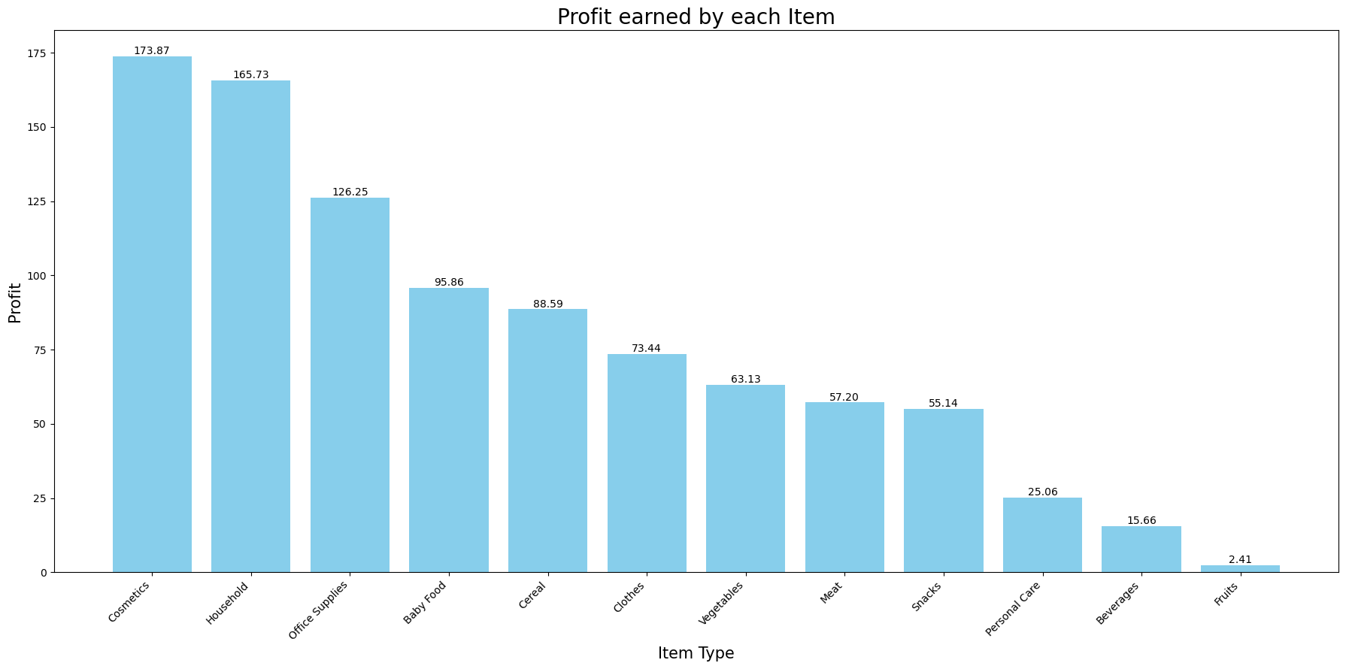
The profit margin in Cosmetic products are highest while in fruits they are lowest. Also Cosmestic Product where the highest sold products this means highest company's profit share belong to this product.

Slide 22
Over the period of time there is growth in the sales of the Amazon company but there are some regions where the sales is decreasing company need to pay attention to those regions.
Sales Channel also impact the sales of the company. It’s clearly seen from the graph that with time the online sales are increasing as compared to offline sales channel.
Best thing about company is it’s sales. It’s not dependent on any one product or item instead the sales of item is distributed widely which make it more compactable with the market.
Some product perform really well like Cosmetic, Office supplies with some products not doing well such as meat and snacks. Company should really pay attention to this products while make some changes or better offer for sales of such products.
Conclusion

Slide 23


Slide 24
INTRODUCTION
Heart disease is a significant health concern worldwide, and understanding its causes and risk factors is crucial for prevention and treatment. This data analysis report aims to provide insights into the prevalence, patterns, and potential predictors of heart disease based on a comprehensive analysis of available data. By examining various demographic, lifestyle, and medical factors, we hope to identify key findings and trends that can inform strategies for early detection, intervention, and improved patient outcomes.

Slide 25
Health is real wealth in the pandemic time we all realized the brute effects of covid-19 on all irrespective of any status. You are required to analyze this health and medical data for better future preparation.
Do ETL: Extract- Transform and Load data from the heart disease diagnostic database You can perform EDA through python.
The database extracts various information such as Heart disease rates, Heart disease by gender, by age
Research
Question

Slide 26
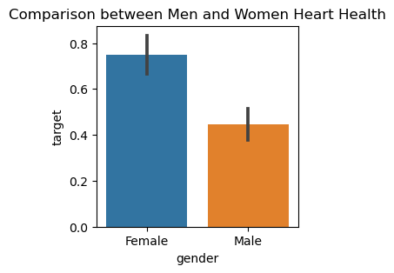
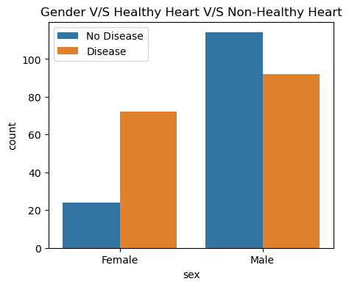
KEY FINDINGS
Percentage of Females with Heart Disease : 75 %
Percentage of Males with Heart Disease : 44.66 %
We can see that out of total female population most of females are prone to heart disease.
While out of total male population the males without heart disease are more as compared to males with heart disease.

Slide 27
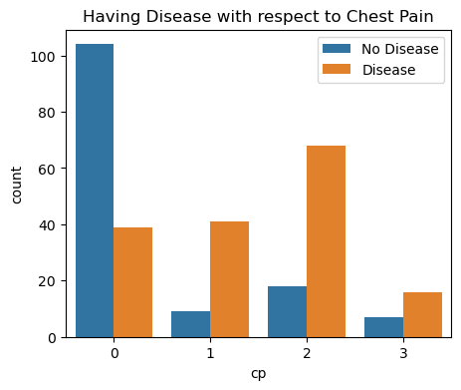
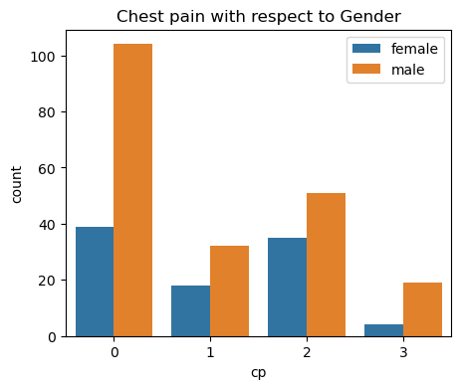
ANALYSIS OF CHEST PAIN
Most of the person who is having 2nd category of chest pain i.e Non-angina chest pain are supposed to have heart disease.
While person with 0 category of chest pain does not have much chances of heart disease.
Checking which type of chest pain in which Gender ?
0 chest pain mostly occur in male as comapred to other type of chest pain this means male have less chance of heat disease.

Slide 28
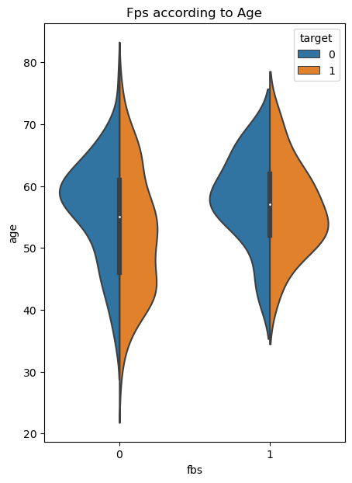
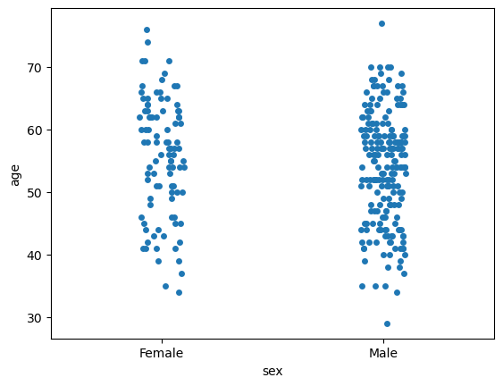
ANALYSIS ACCORDING TO AGE
most of the dAta for male we have around 50 to 60 age group where as for women very few data for age between 30 to 50 and
above 70.
females from age 25 to 90 have a chances of having heart disease while most of them have heart disease between age 45 to 60.

Slide 29
Mostly female are prone to Heart disease as compared to male.
Conclusion

Slide 30


Thank You
Harsh Rajendra Kadam
harshkadam997@gmail.com

